Slide 1
8.1 Programming
Maintainability

Slide 2
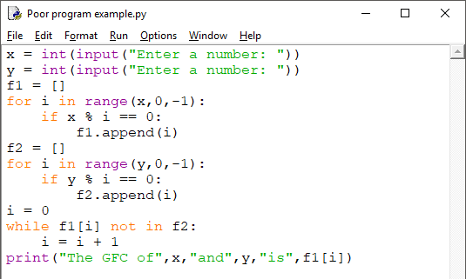
A program that is not well- maintained

Slide 3

A program that is not well-maintained

Slide 4
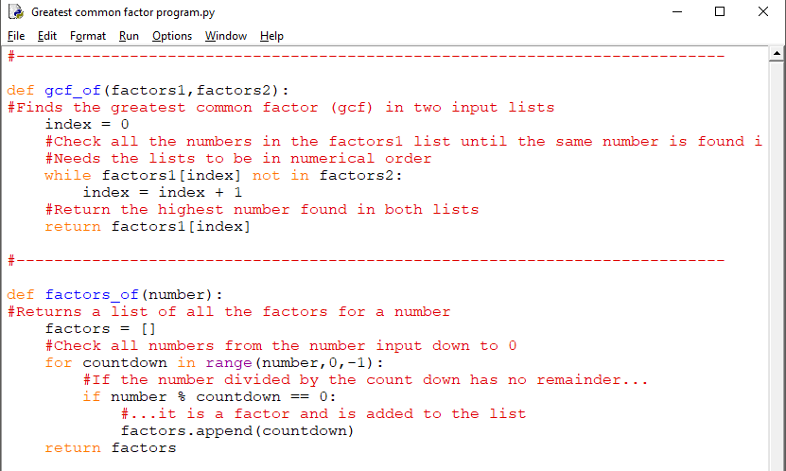
A well-maintained program

Slide 5
A well-maintained program
Using comments to divide the program into distinct sections.

Slide 6
A well-maintained program
Using comments to explain what various parts of the program are designed to do.

Slide 7
A well-maintained program
Using sensible, descriptive identifier names.

Slide 8
A well-maintained program
Using indentation.

Slide 9

Writing maintainable code
To make your code as easy to read and maintain as possible, make sure you use:
Comments to divide the program into sections and explain:
The program’s purpose.
Sections of code – typically, selections, iterations and procedures.
Any unusual approaches taken.
White space to make program sections easier to see.
Indentation for every selection and iteration branch.
Descriptive variable names, explaining each variable’s purpose with a comment when it is declared.
Procedures and/or functions to:
Structure code.
Eliminate duplicate code.
Constants – declared at the top of the program.

Slide 10


